Slide 1

Exploratory Data Analysis
G2M Insight for Cab Investment Firm
01/02/2024

Slide 2
Agenda
Executive Summary
Problem Statement
Approach
EDA
EDA Summary
Recommendations

Slide 3
Problem Statement
XYZ is a private firm in US. Due to remarkable growth in the Cab Industry in last few years and multiple key players in the market, it is planning for an investment in Cab industry and as per their Go-to-Market(G2M) strategy they want to understand the market before taking final decision.

Slide 4
Dataset
There are 4 individual data sets. Time period of data is from 31/01/2016 to 31/12/2018.
Cab_Data.csv – this file includes details of transaction for 2 cab companies
Customer_ID.csv – this is a mapping table that contains a unique identifier which links the customer’s demographic details
Transaction_ID.csv – this is a mapping table that contains transaction to customer mapping and payment mode
City.csv – this file contains list of US cities, their population and number of cab users

Slide 5
The data was combined to form a master dataset. The master dataset was then used for analysis.

Slide 6
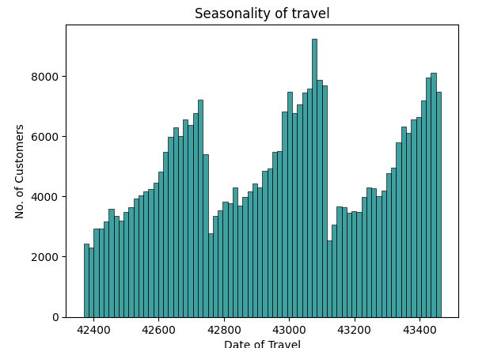
Seasonality of Cab Usage

Slide 7
The dates of travel were encoded into a new form. Most customers use cabs seasonally. From the dates before 42400, the use of cabs increase gradually up to date 42721 where it drops sharply. After that the use of cabs start increasing again gradually. The use peaks again at date 43105 after which it drops drastically. The cycle repeats again and increases up to date 43456. It can be concluded that peak dates for cab activity are around 42271, 43105 and 43456

Slide 8
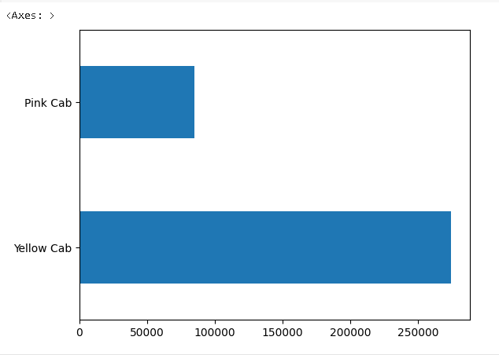
Use of Cab by Company

Slide 9
Many customers use the yellow cab

Slide 10
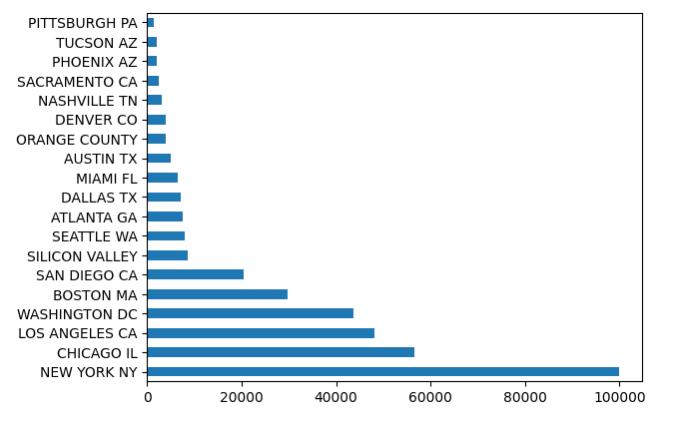
Cab Usage by City

Slide 11
Most cab usage is found New York NY, Chicago IL, Los Angeles CA, Washington DC, San Diego CA and Boston MA

Slide 12
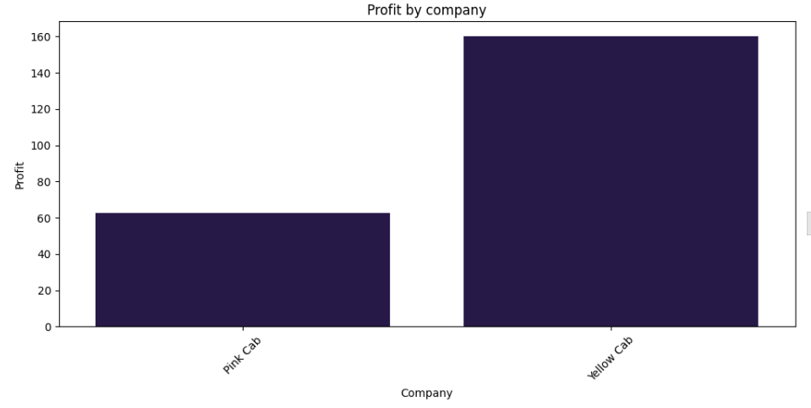
Profit Comparison

Slide 13
Generally, the yellow cab makes more profit than the pink cab.

Slide 14
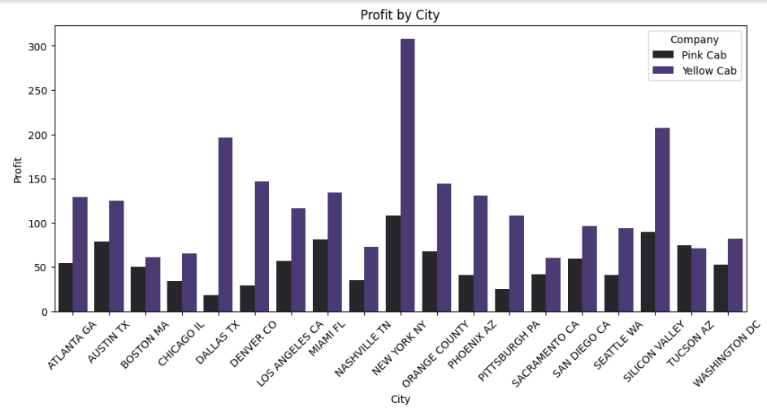
Profit Analysis by City

Slide 15
The yellow cab makes higher profits in all the cities except Tucson AZ than the pink cab. In Tucson AZ, the pink cab makes a slightly higher profit. The cities where the yellow cab has a higher profit margin are Dallas TX, Denver CO, New York NY and Silicon Valley

Slide 16
New York city has the highest number of cab users, Pittsburg PA the least

Slide 17
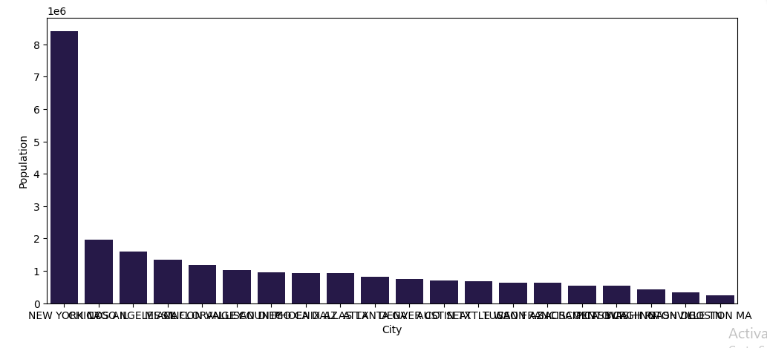
Comparison of the Population Sizes in the Cities

Slide 18
New york has the highest population, Boston MA the least.

Slide 19
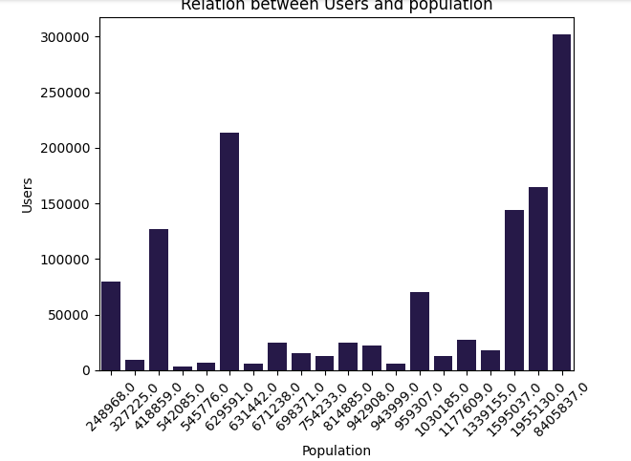
Relationship Between Users and Population

Slide 20
There is no direct relationship between the number of cab users and the population of the city, save for the three most populated cities. The cities with the most cab usage are Boston MA, Washington DC, San Francisco CA, San Diego CA, Los Angeles CA, Chicago IL, New York NY

Slide 21
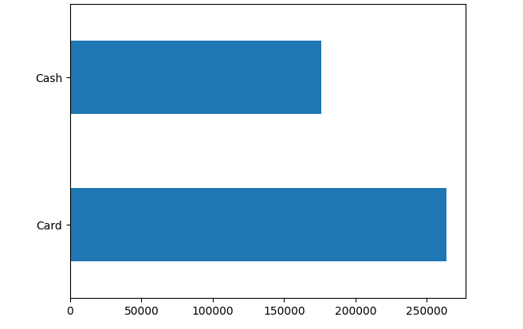
Visualizations of the Modes of Payment

Slide 22
All the customers use both modes of payment, but a large percentage of them use Card

Slide 23
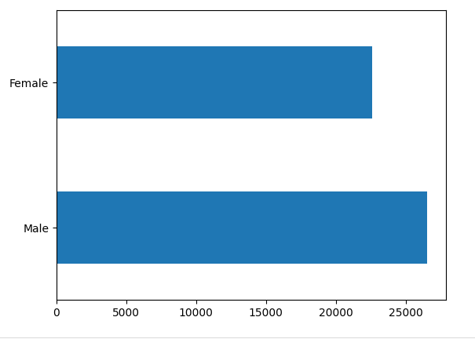
Visualization of Gender

Slide 24
More males use cabs than females by about 50000

Slide 25
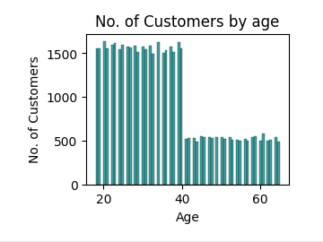
Distribution of Customers by Age

Slide 26
Generally younger people (from 19 years up to 40 years) prefer using cabs than older people (40 years up to 65)

Slide 27
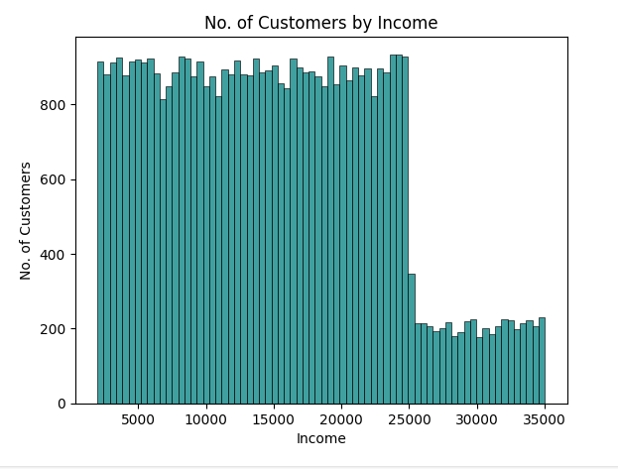
Distribution of Customers by Income

Slide 28
Customers with an income of less than 25000 dollars are more than Customers with an income of between 25000 dollars and 35000 dollars

Slide 29
Thank You

Slide 30
From the analysis, it can be concluded that it is better to invest in the yellow cab.

